Slide 1
Remote Energy Security Technologies Collaborative
Helping remote communities kick their oil addiction

Slide 2
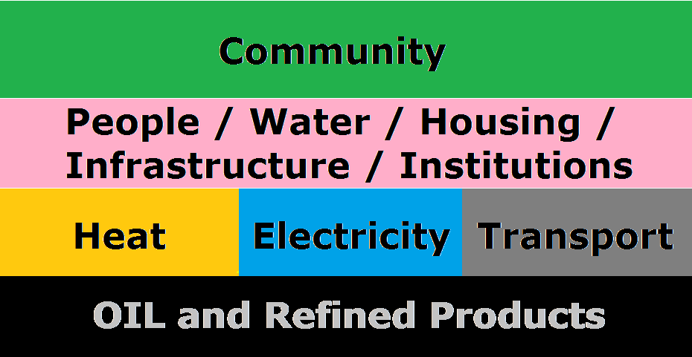
RESTCo
Heating fuel, diesel, gasoline, propane, kerosene:
it all comes from oil – produced and refined in the south.

Slide 3
RESTCo
Oil – highly valuable commodity:
Feedstock for plastics
Energy store from millions of years of collecting solar energy
Liquid makes for easy transfer and storage
Very high energy density

Slide 4
RESTCo
Oil – costly commodity:
Finite supply = rising prices
Extreme locations / techniques
Pollution: water, air, land, thermal, noise
Carbon dioxide emissions > GHGs > climate change

Slide 5
RESTCo
Oil – how much longer can remote communities rely on there being enough, at an affordable price, and tolerate the environmental and climate impacts resulting from its use?

Slide 6
RESTCo
Oil use for fuel means:
Reduced Arctic ice
Permafrost melt
Stronger storms
Weather instability
Changing wildlife locations and migration patterns …

Slide 7
RESTCo
Oil – what’s the alternative?
The RESTCo Vision for reducing the oil vulnerability of remote northern communities

Slide 8
RESTCo
The RESTCo Vision for Energy
Energy efficient, healthy housing
Efficient electric and hybrid vehicles, useful configurations
Integrate local, renewable energy sources

Slide 9
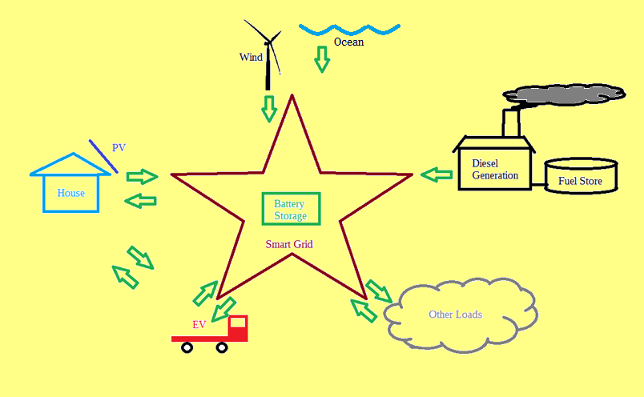
RESTCo

Slide 10
RESTCo
Oil – what’s the alternative?
Energy efficient, healthy, robust, adaptable, transportable housing designed for the north, by the north
TRIFLEX Housing

Slide 11
RESTCo
TRIFLEX Housing
Accommodates permafrost by using 3 adjustable points to carry the entire structure

Slide 12
RESTCo
TRIFLEX Housing
Extremely energy efficient due to high insulation, structure sealing, energy recovery ventilator, LED lighting …

Slide 13
RESTCo
TRIFLEX Housing
Robust enough to be transported after construction if necessary, using 3 foundation points on skis, wheels or floats

Slide 14
RESTCo
TRIFLEX Housing
No interior load-bearing walls means complete flexibility in designing interior, or use of movable walls to retain flexibility

Slide 15
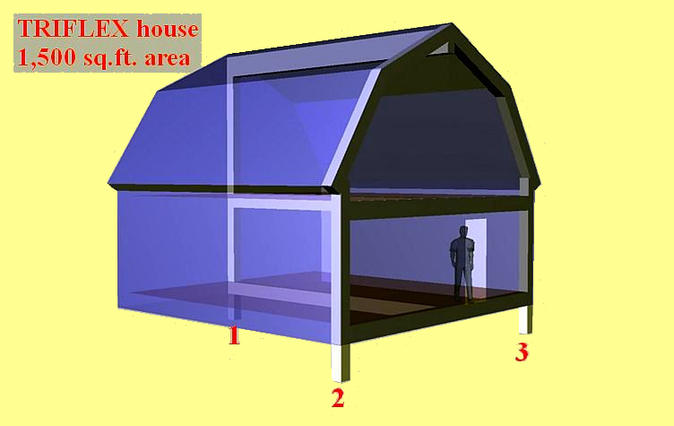
RESTCo

Slide 16
RESTCo
TRIFLEX Housing
3 foundation points
Flex place
Flex interior layout
Supports renewable energy production

Slide 17
RESTCo
Oil – what’s the alternative?
Local transportation that uses less or no oil-based fuels, such as electric and hybrid vehicles, in forms that fit the north: ATVs, boats, trucks, and snowmobiles

Slide 18
RESTCo
Electric & Hybrid Vehicles
Modern advanced batteries, with proper thermal management, can deal with cold temperatures
Large vehicle batteries can store energy to power a house if there is a power outage

Slide 19
RESTCo
Electric & Hybrid Vehicles
In remote communities, roads are short, so range is usually not a big issue
A small electric truck can travel a useful distance on the electricity used by a block heater so the diesel or gasoline truck can start

Slide 20
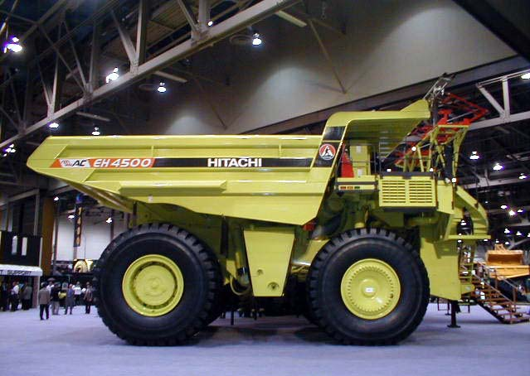
RESTCo
Electric & Hybrid Vehicles
Mid-range electric-hybrid Euclid-Hitachi truck Payload: 255 tonnes (other sizes available)

Slide 21
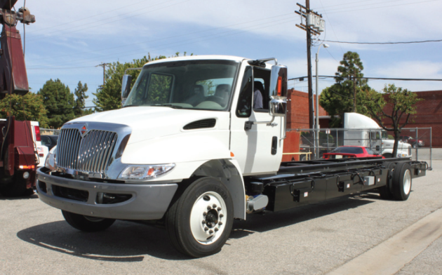
RESTCo
Electric & Hybrid Vehicles
Balqon medium all-electric truck, 100 km/h, 4 tonne capacity, 150 km range, 3 hr recharge
Suitable for hauling water, septic waste

Slide 22
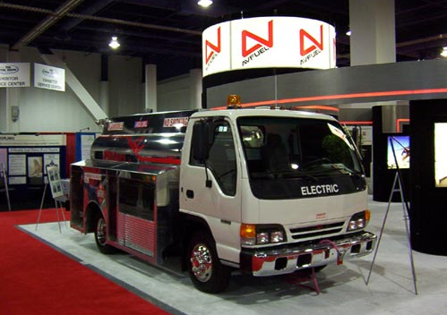
RESTCo
Electric & Hybrid Vehicles
Isuzu NPR converted to electric and customized in Canada. 40 km/h, up to 5 tonne payload, 30-80 km range (depends on battery option chosen)

Slide 23
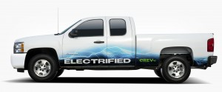
RESTCo
Electric & Hybrid Vehicles
A light duty (3/4 ton) extended range electric truck (hybrid) for the North (50 km electric, 600 km gasoline range per charge)

Slide 24
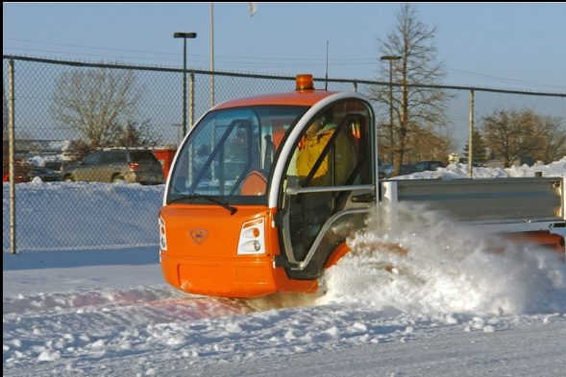
RESTCo
Electric & Hybrid Vehicles
Nemo all-electric truck, 40 km/h, 500 kg capacity, 100+ km range, 3 hr recharge
Suitable for maintenance, service workers

Slide 25
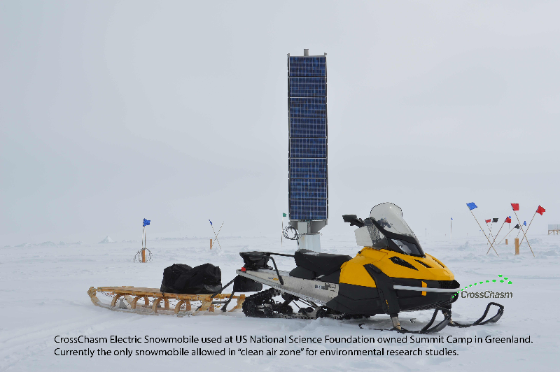
RESTCo
Electric & Hybrid Vehicles

Slide 26
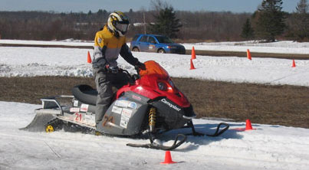
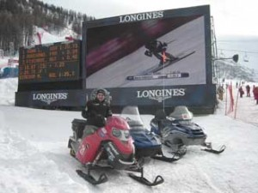
RESTCo
More Electric Snowmobiles

Slide 27
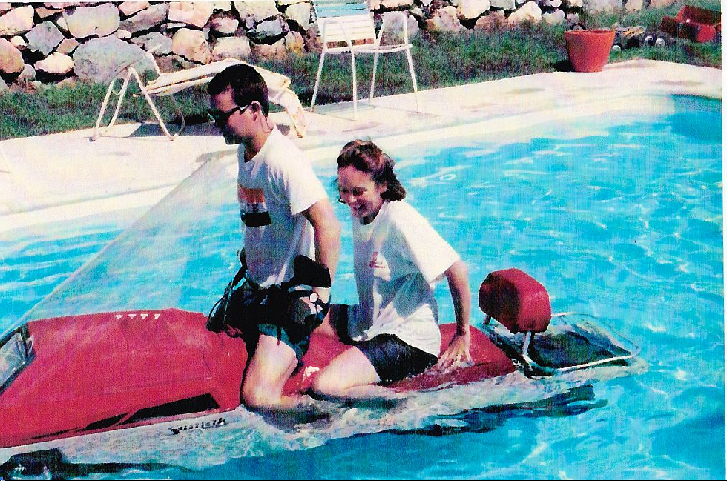
RESTCo
Electric & Hybrid Vehicles
What if your quiet, electric snowmobile could float? ‘Snowmoboat’: survive thin ice.

Slide 28
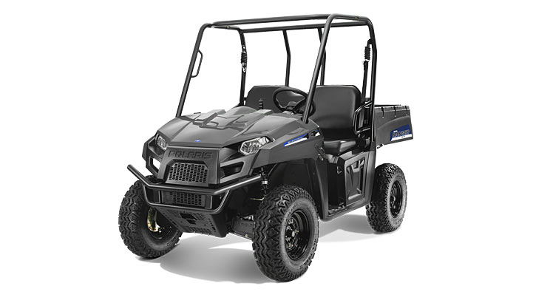
RESTCo
Electric & Hybrid Vehicles
Polaris 2014 Electric Ranger ATV

Slide 29
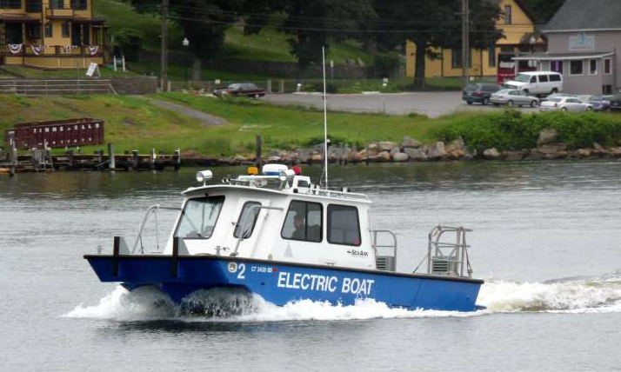
RESTCo
Electric & Hybrid Vehicles
Electric Work Boat

Slide 30
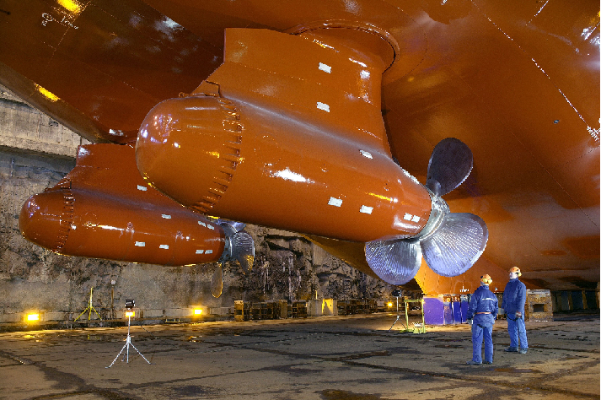
RESTCo
Electric & Hybrid Vehicles
Larger power plants available if required (9500 horsepower azipod version shown)

Slide 31
RESTCo
Oil – what’s the alternative?
Switching to renewable, local energy sources, such as tidal, ocean currents, submerged run-of-river, wind, solar …

Slide 32
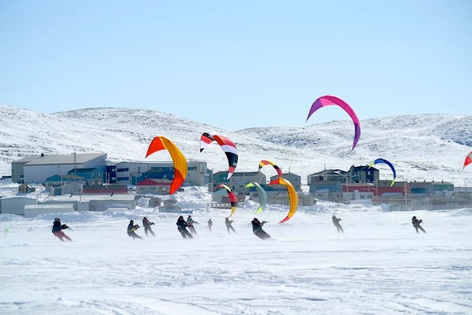
RESTCo
Does it get windy in the north?
Kite
Skiing in Pang

Slide 33
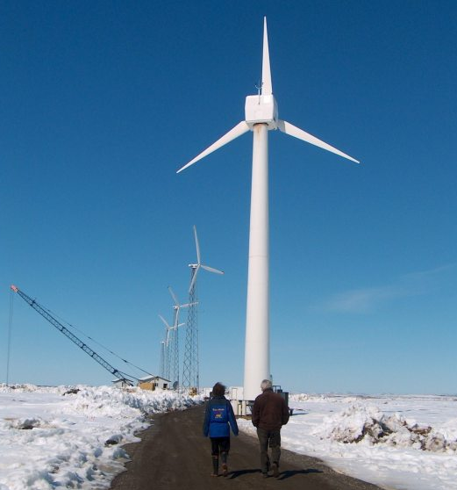
RESTCo
Wind turbines at Kotzebue, Alaska
Average wind speeds in Pang are about 4 m/s (25 km/h), and blow from the west about 27% of the time.

Slide 34
RESTCo
Northern communities have more than wind resources
Eastern Nunavut has high tidal range
For 8 months a year, there is plenty of solar energy available
Rivers can provide run-of-river hydroelectricity
Ocean currents can turn generators

Slide 35
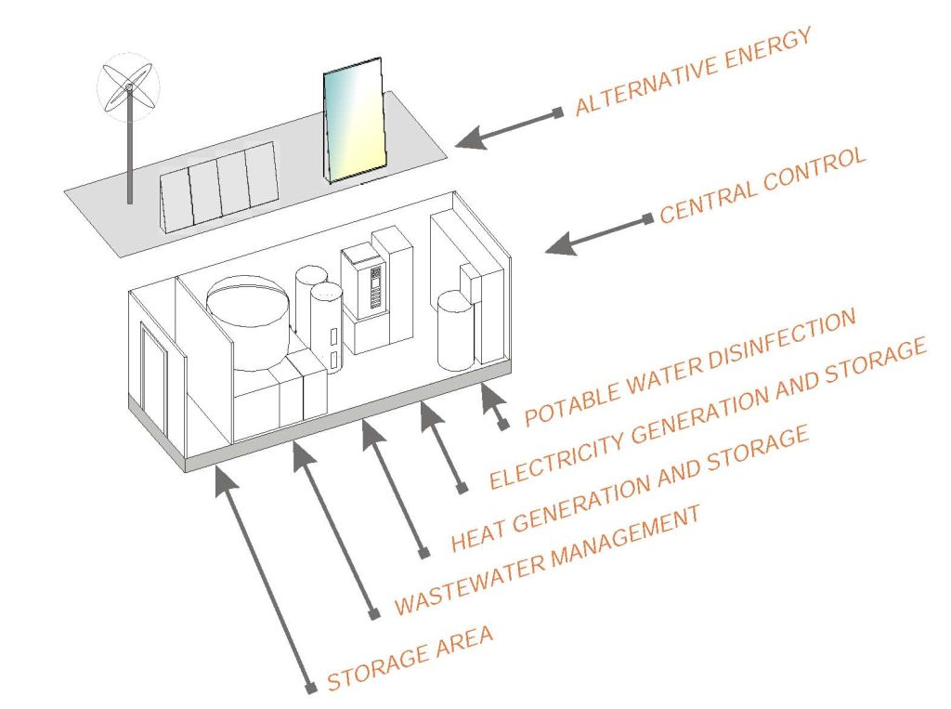
RESTCo
Utility ‘closet’ for cluster of houses (commercially available now)

Slide 36
RESTCo
Oil – in the interim:
Reduce oil use and dependence
Clean up the messes oil has already made
Prepare for oil spills to come
Building local energy self-sufficiency

Slide 37
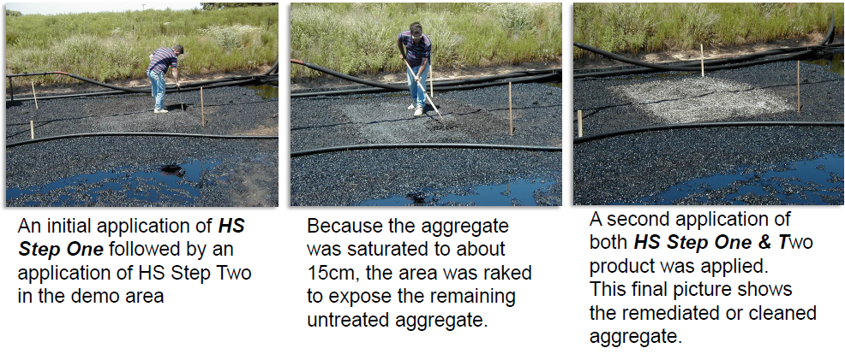
RESTCo
Clean up the messes oil made

Slide 38
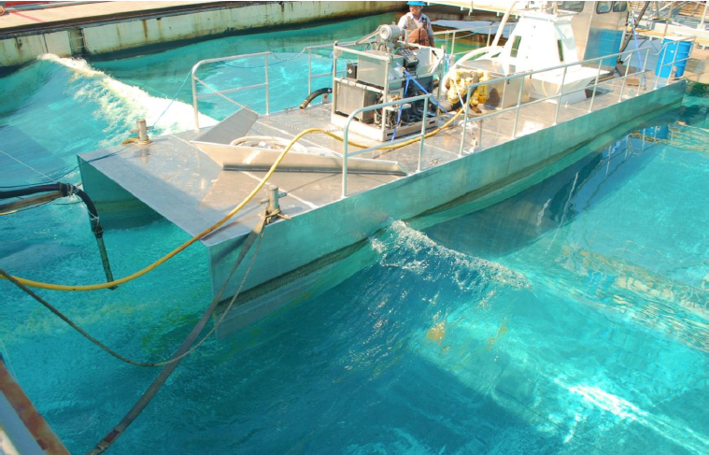
RESTCo
Prepare for oil spills yet to come
Extreme
Spill
Technology
Up to 94.4% oil recovery in one pass
Effective spill recovery in waves, BEFORE the oil hits shore

Slide 39
Remote Energy Security Technologies Collaborative
Integrated Community Solutions
Talk to us, we can help.

Slide 40
Remote Energy Security Technologies Collaborative
Helping remote communities kick their oil addiction RESTCo.ca

